Slide 1


MIT Media Lab
Viral Communications
September 2019

Slide 2

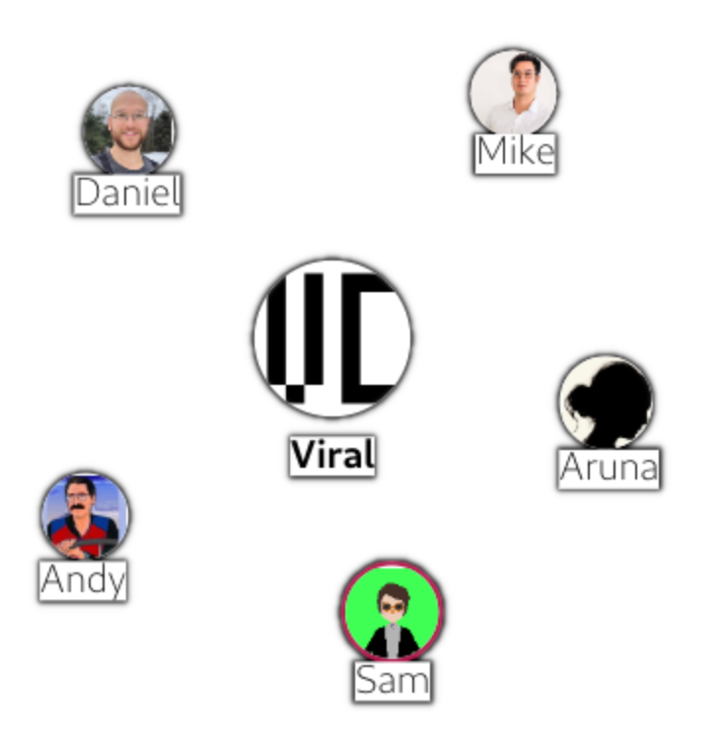

A locally owned and operated platform for community events and discussions
Easy moderation tools put local leaders in control
Flexible options for public and private communication
Extensible free software architecture
Viral Communications
September 2019
Andrew Lippman

Slide 3




Features
Public homepage
Events
Working Group 1
Channels
Working Group 2
Discussions
Viral Communications
September 2019
Andrew Lippman

Slide 4
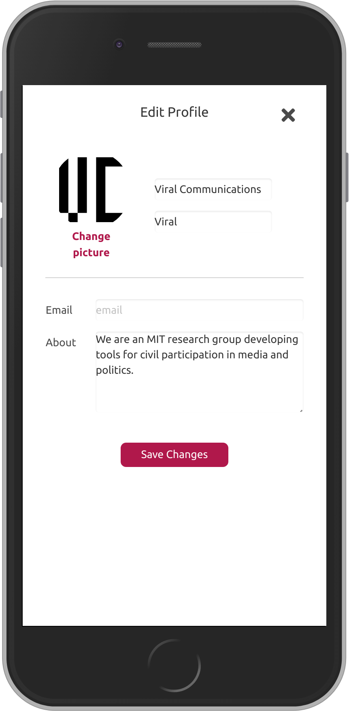
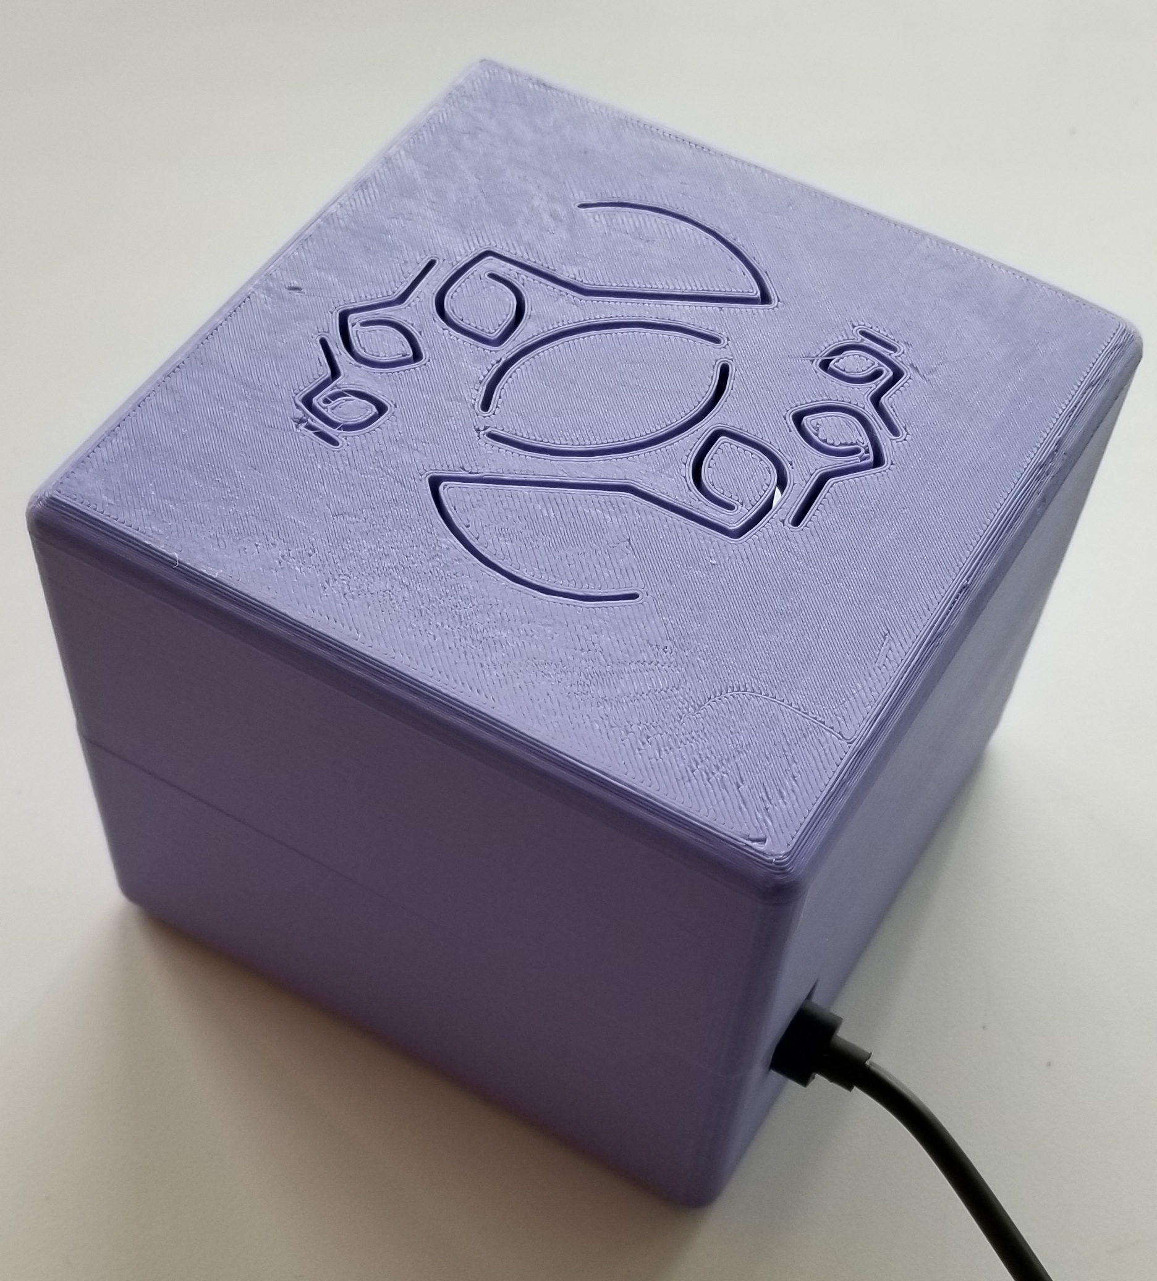

Any group can host their own CivicLink:
1. Install the box and register a public name, i.e. viral.civiclink.network
2. Design the group’s public face. A group website is automatically created!
3. Invite members to the group
Viral Communications
September 2019
Viral Communications
September 2019
Andrew Lippman
Andrew Lippman

Slide 5
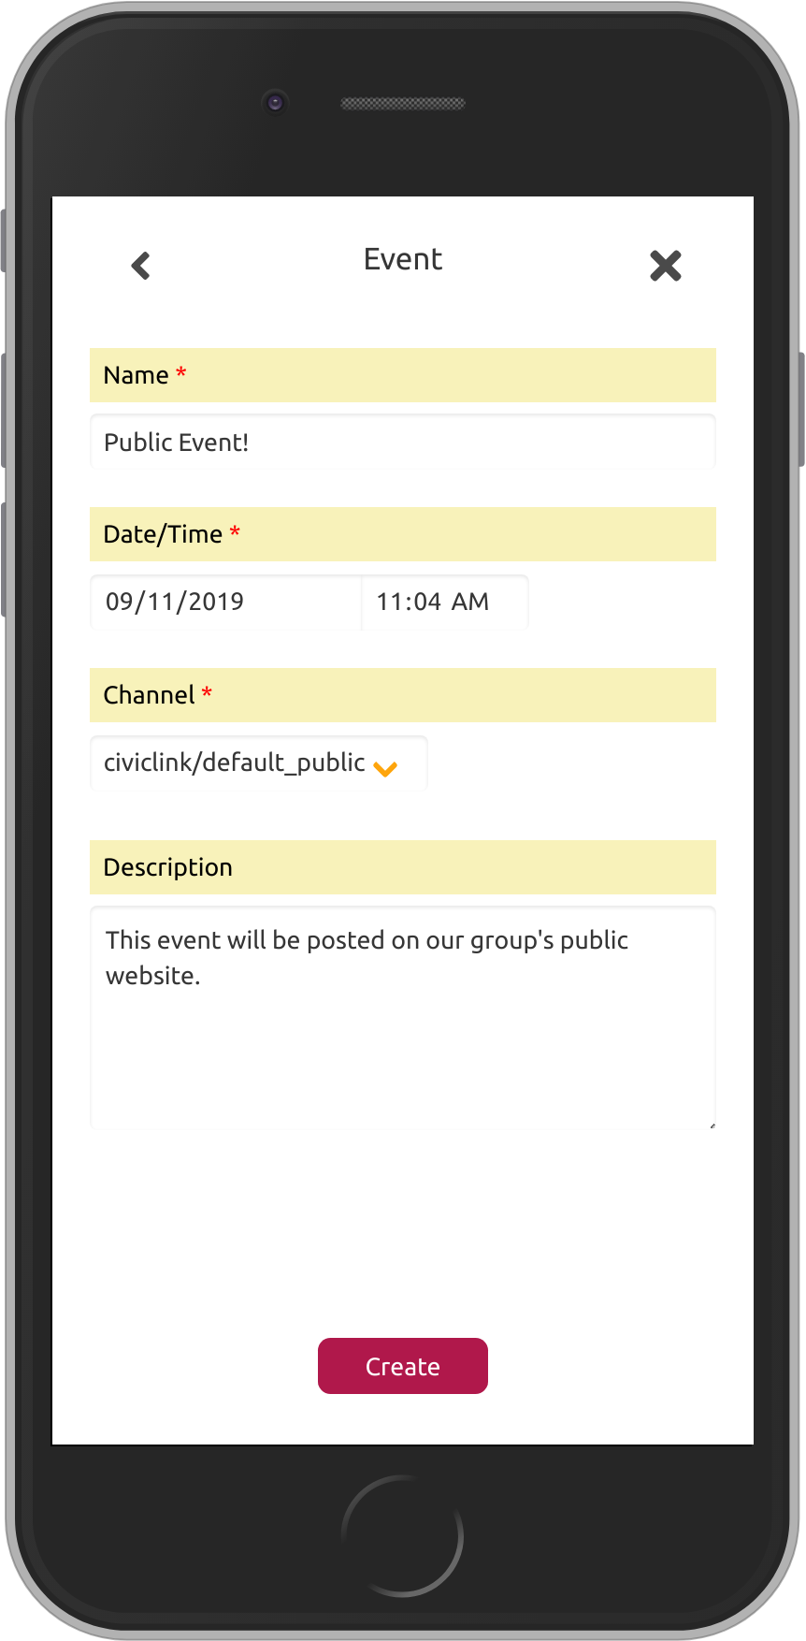
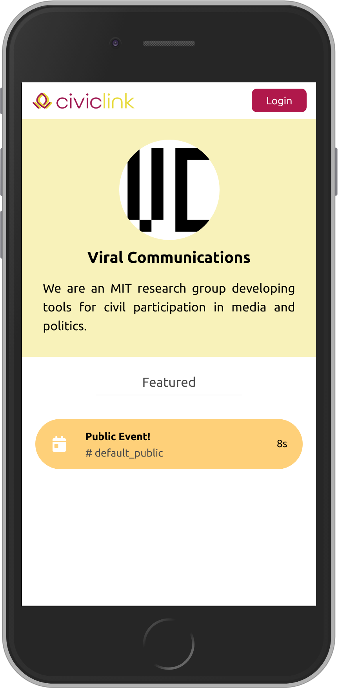
Update the public page by adding content to the “default public” channel
The contents of this channel are automatically posted publicly
Anyone can access this page by visiting viral.civiclink.network
Viral Communications
September 2019
Viral Communications
September 2019
Andrew Lippman
Andrew Lippman

Slide 6
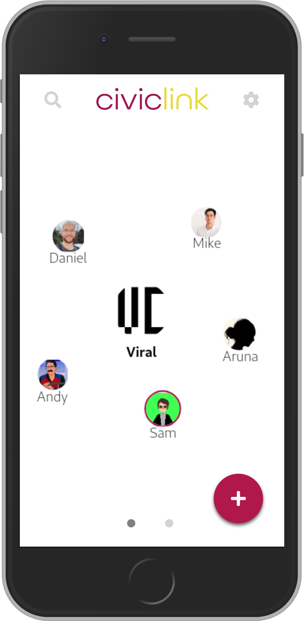
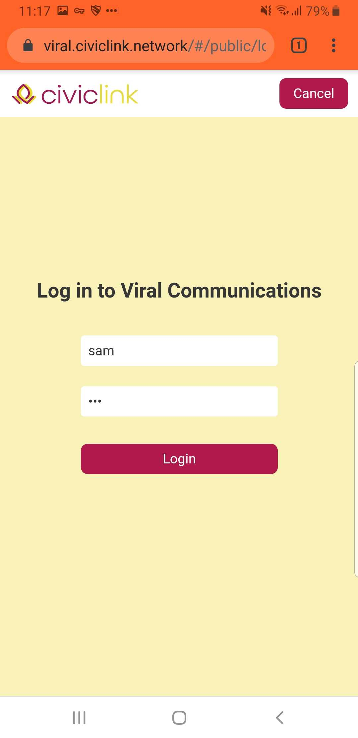
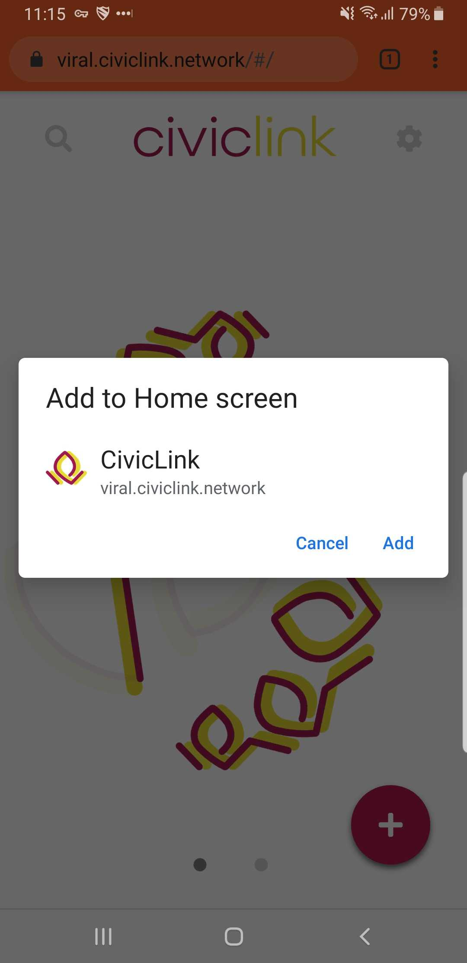
Members can log in to access the CivicLink web app
Viral Communications
September 2019
Viral Communications
September 2019
Andrew Lippman
Andrew Lippman

Slide 7
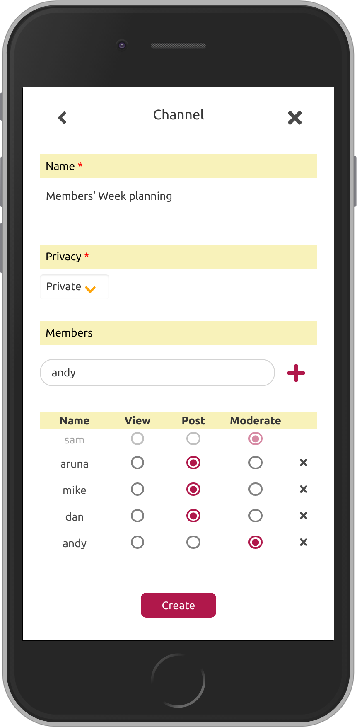
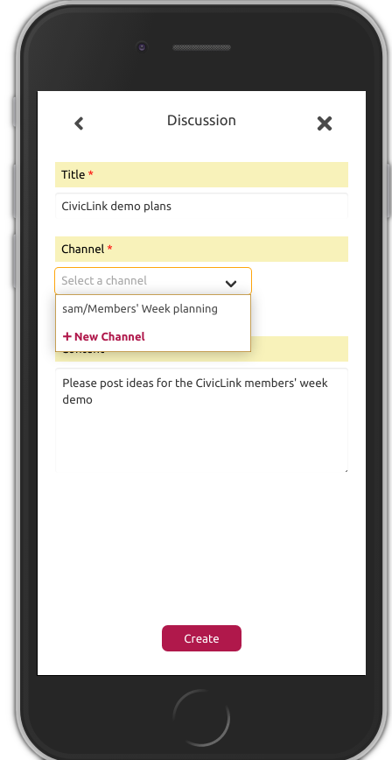
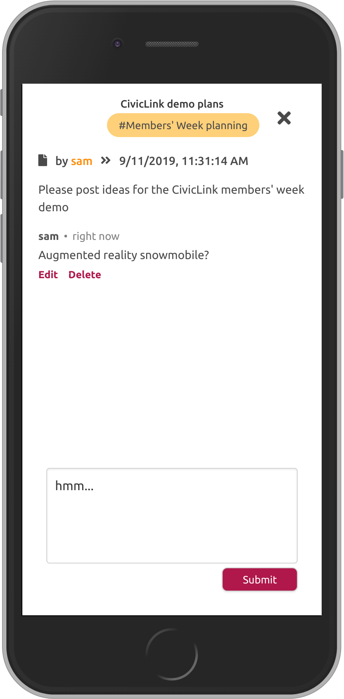
Post events & discussions publicly, or create members-only channels!
Viral Communications
September 2019
Viral Communications
September 2019
Andrew Lippman
Andrew Lippman

Slide 8
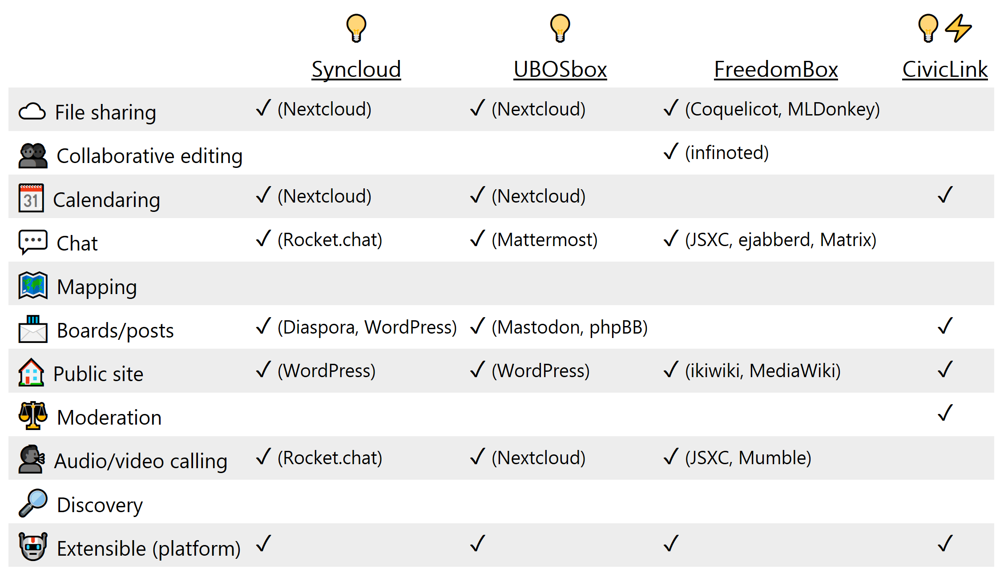
Limitations
No file sharing/editing
No real-time chat
No discovery
Work in progress!
Viral Communications
September 2019
Viral Communications
September 2019
Andrew Lippman
Andrew Lippman

Slide 9
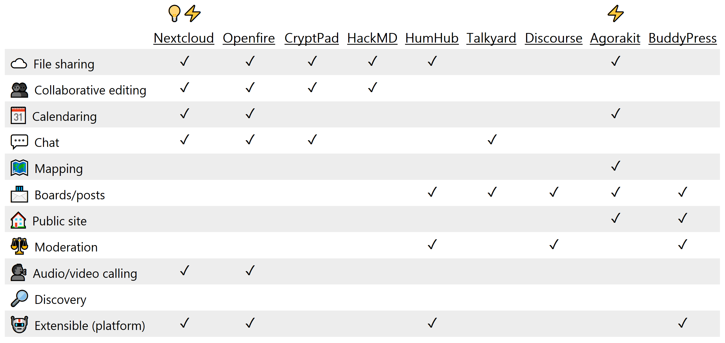
Servers (dedicated)
Viral Communications
September 2019
Viral Communications
September 2019
Andrew Lippman
Andrew Lippman

Slide 10
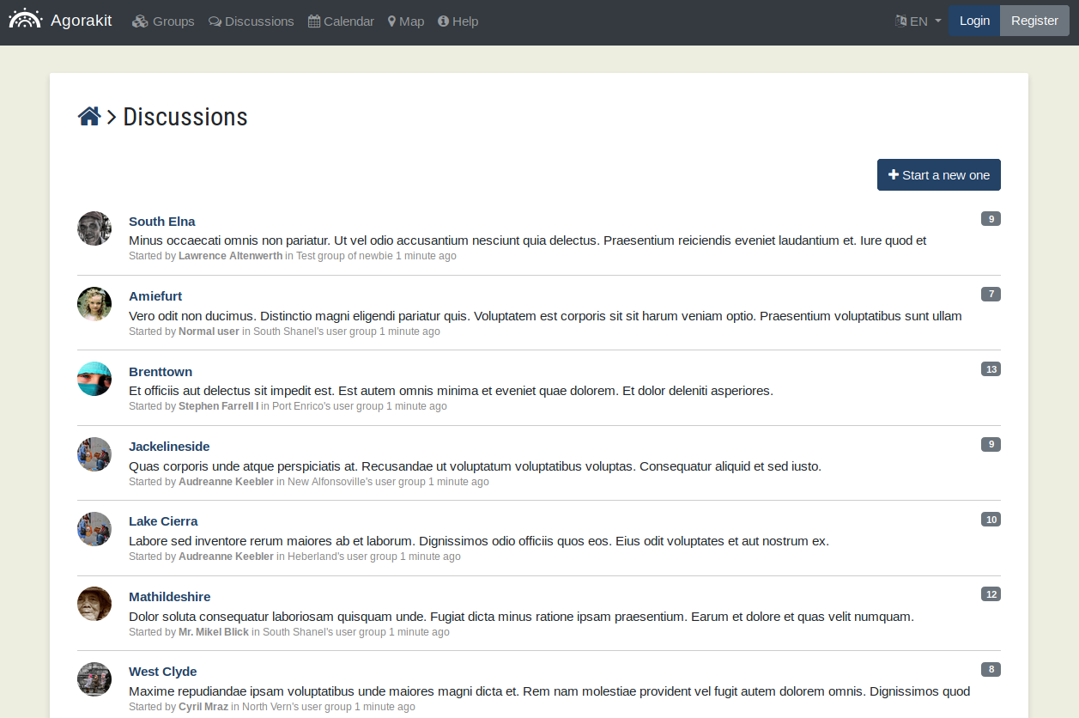
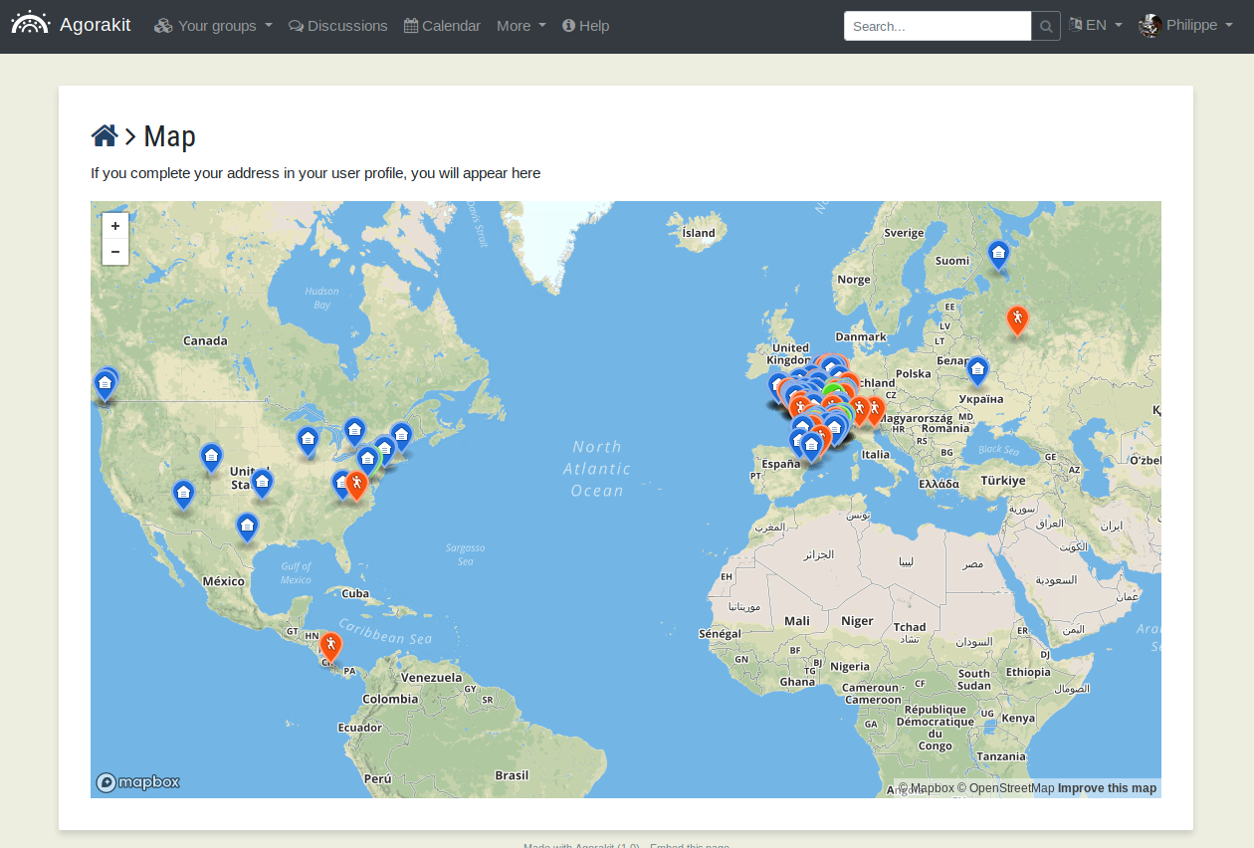
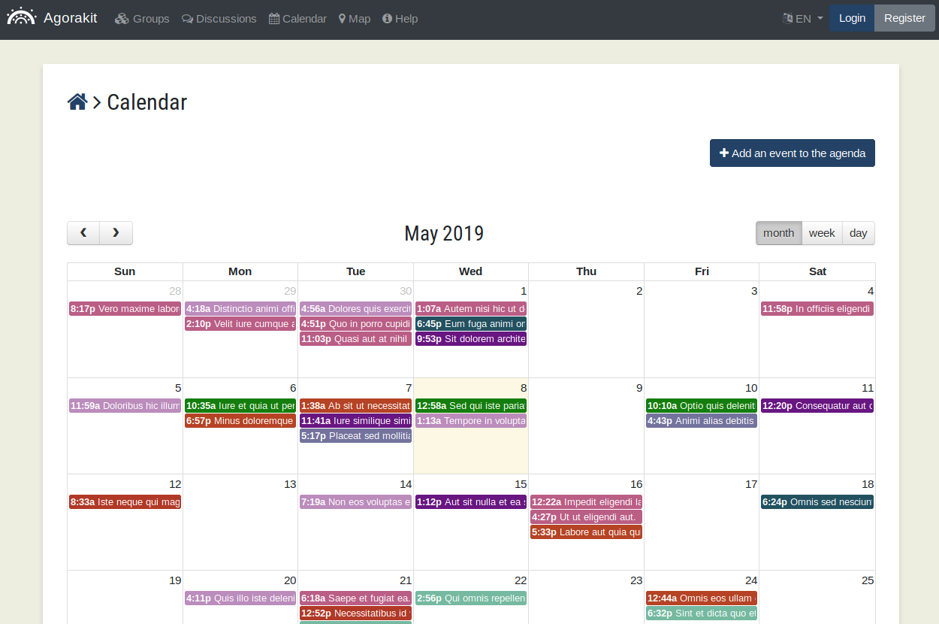
Agorakit
Viral Communications
September 2019
Viral Communications
September 2019
Andrew Lippman
Andrew Lippman

Slide 11
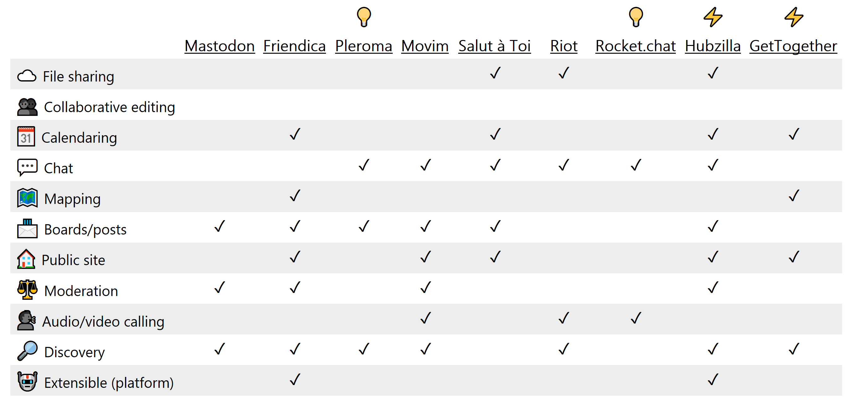
Servers (federated)
Viral Communications
September 2019
Viral Communications
September 2019
Andrew Lippman
Andrew Lippman

Slide 12
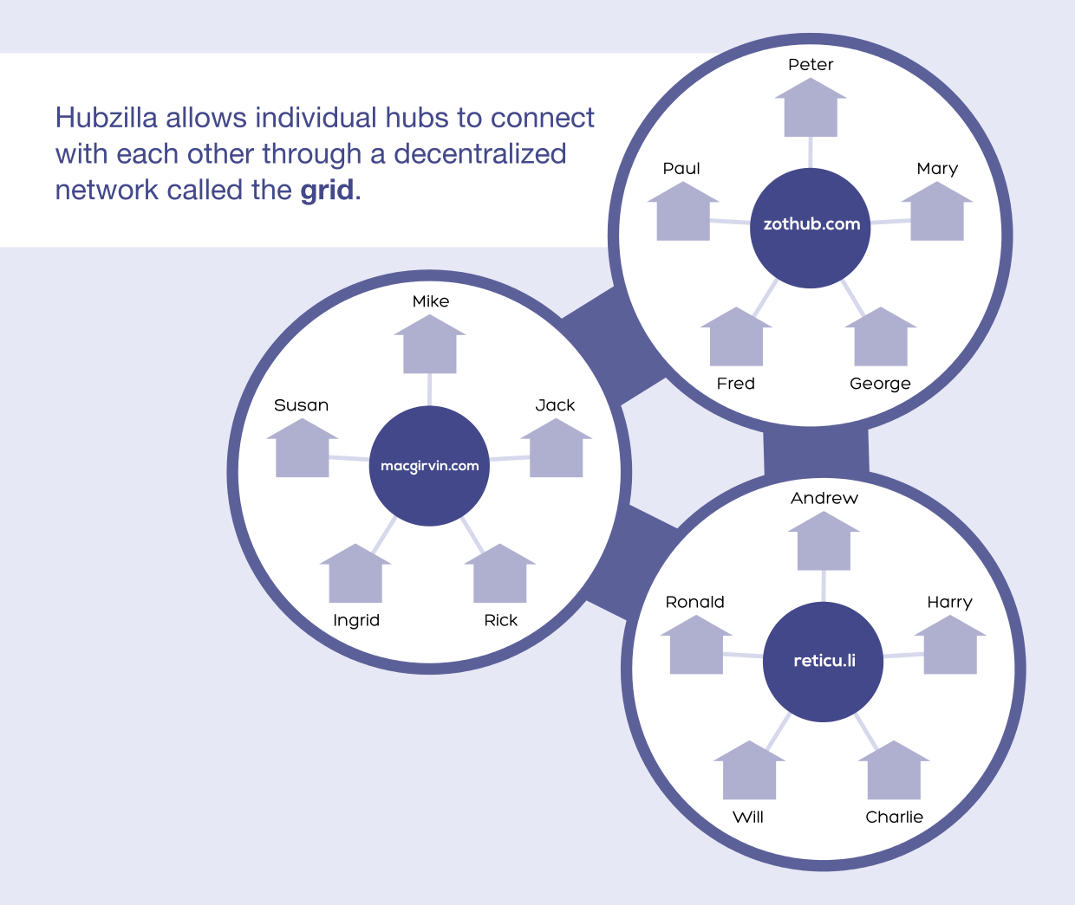
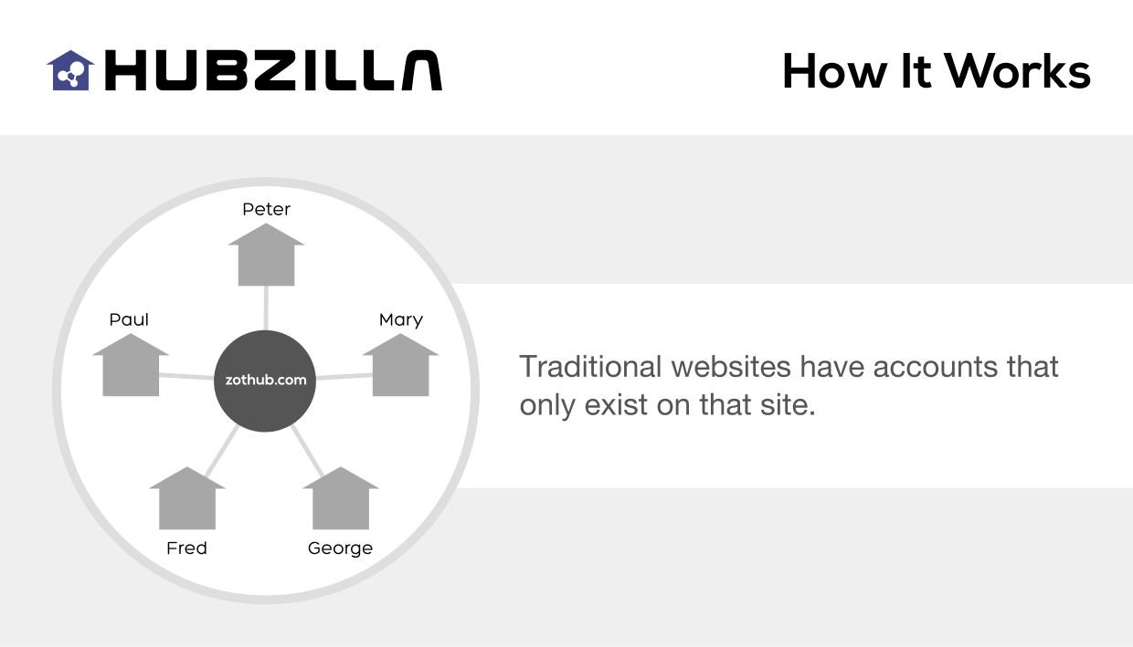
Hubzilla
Viral Communications
September 2019
Viral Communications
September 2019
Andrew Lippman
Andrew Lippman

Slide 13
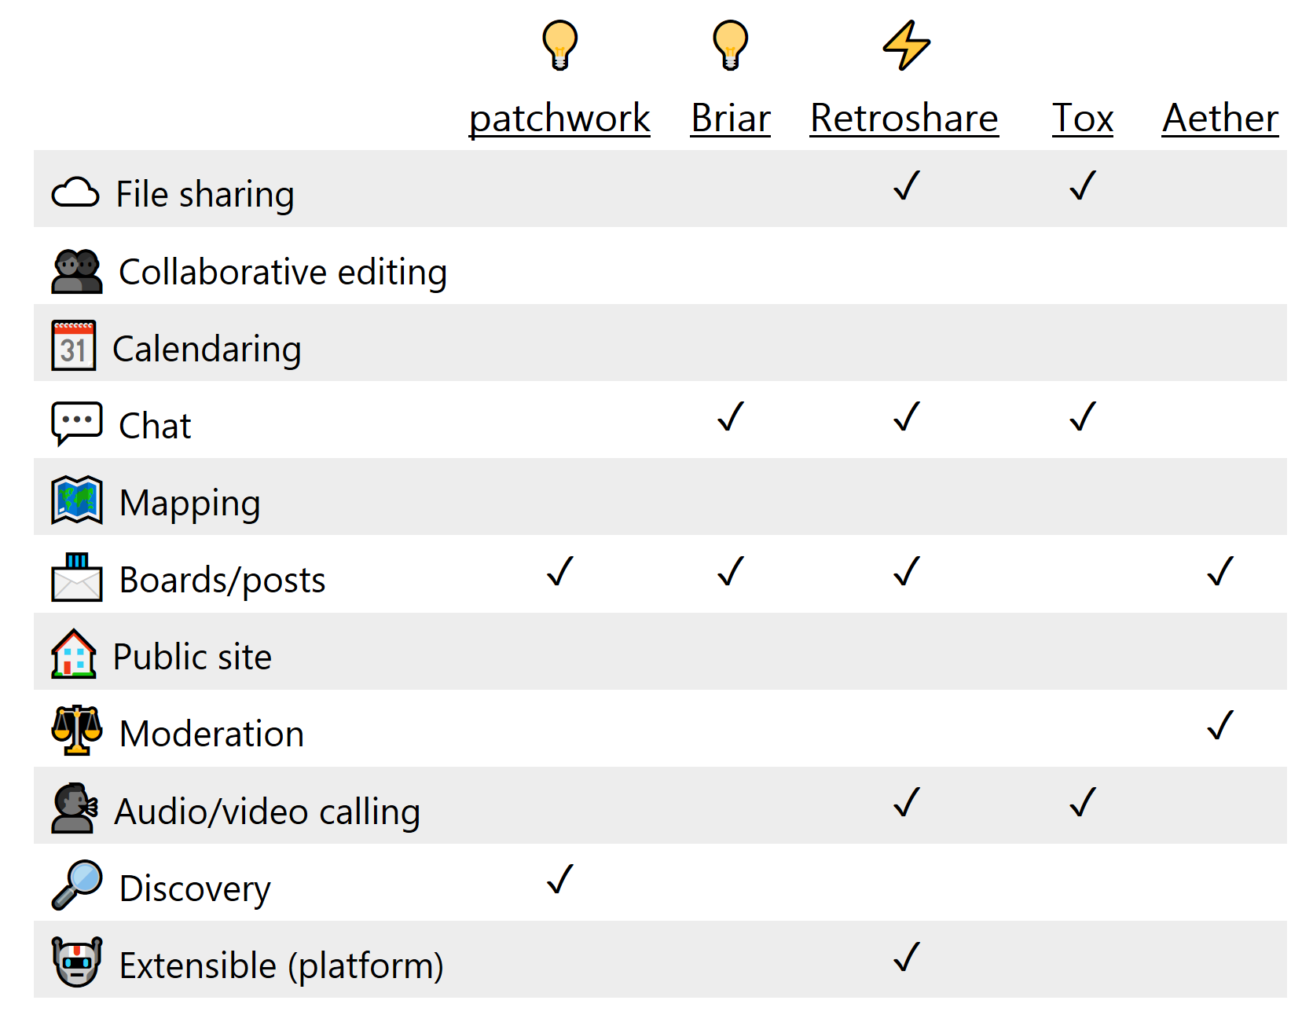
Serverless (P2P)
Viral Communications
September 2019
Viral Communications
September 2019
Andrew Lippman
Andrew Lippman

Slide 14
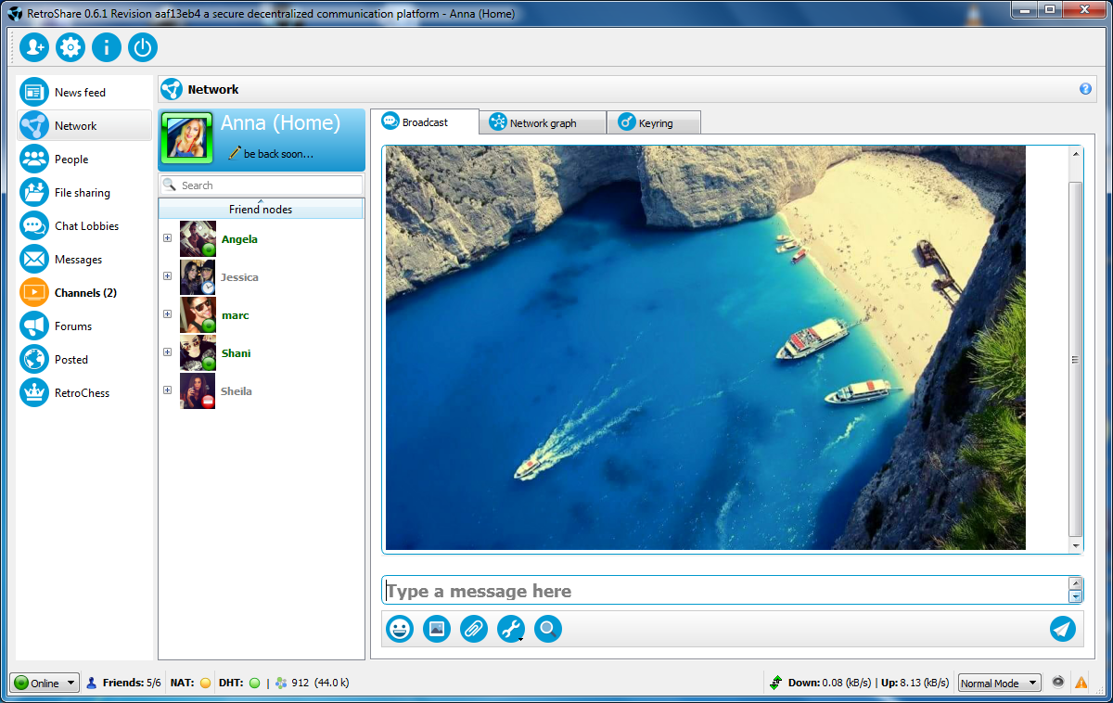
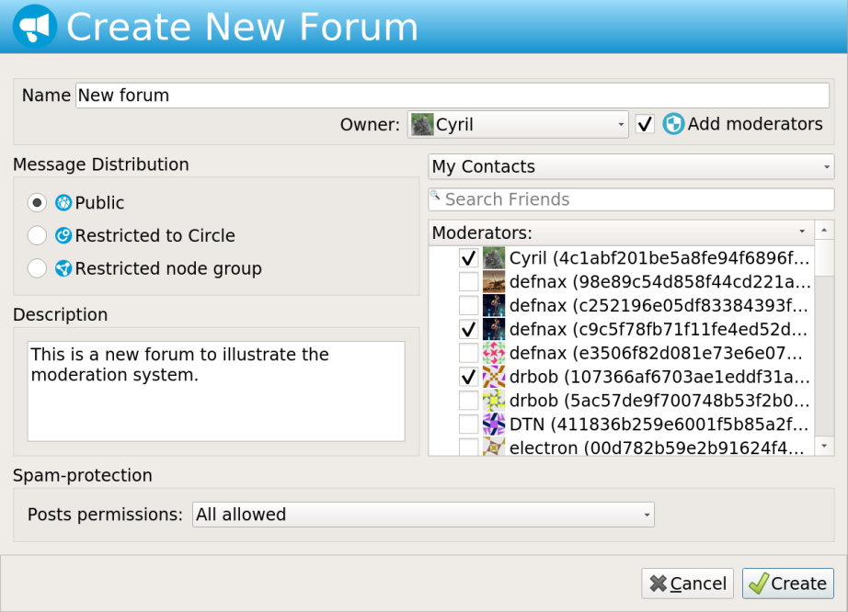
Retroshare
Viral Communications
September 2019
Viral Communications
September 2019
Andrew Lippman
Andrew Lippman

Slide 15
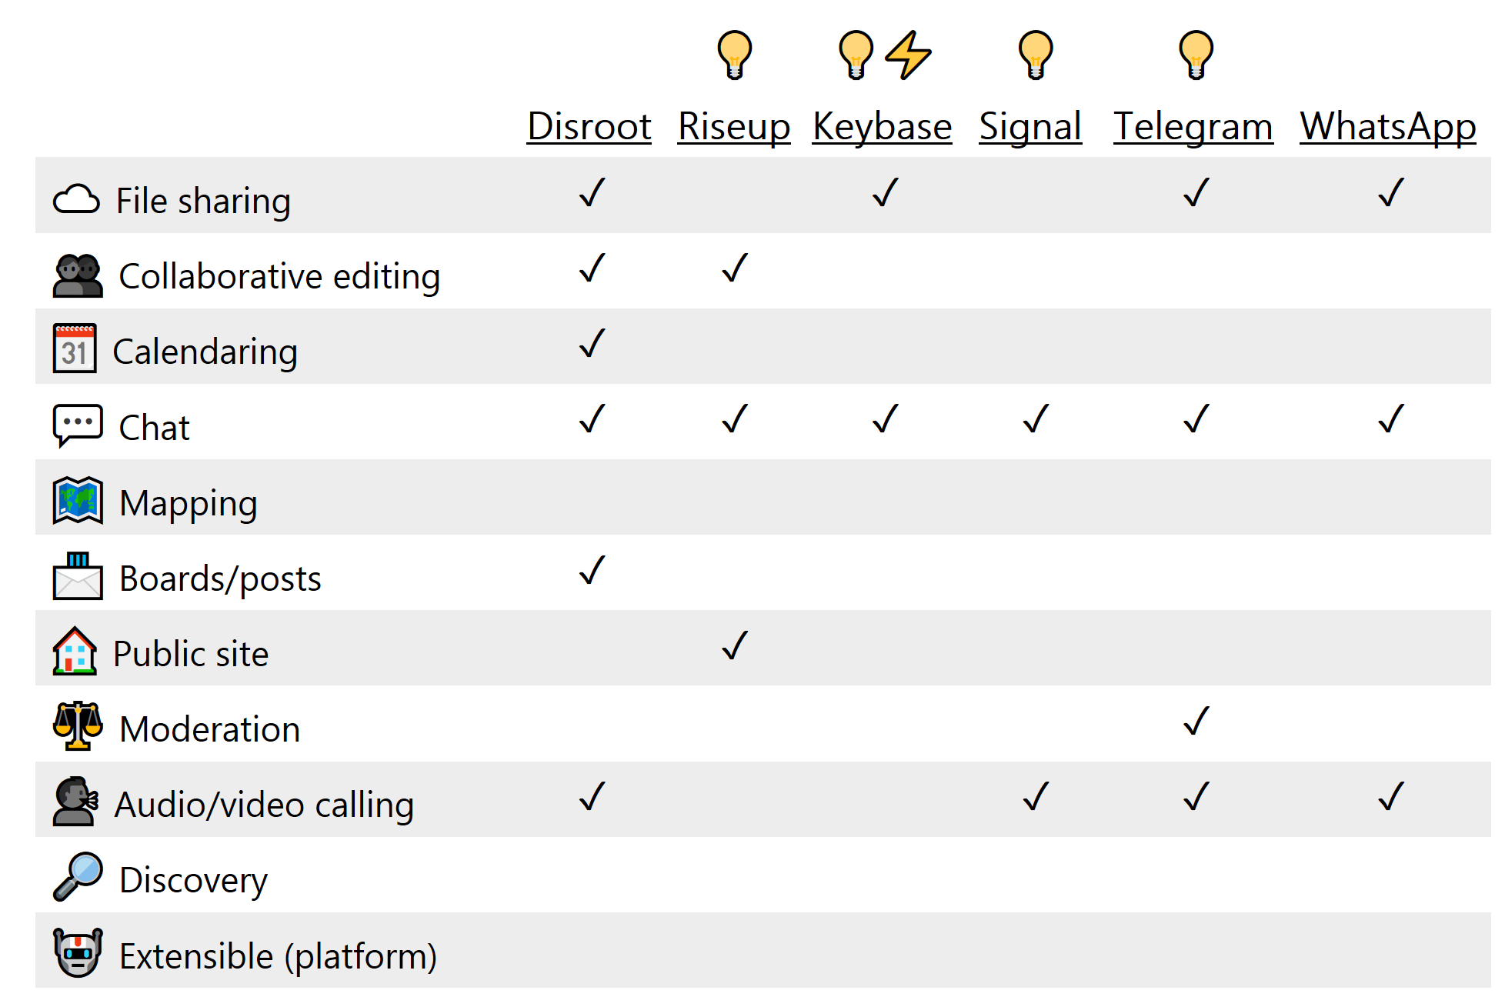
Services (free)
Viral Communications
September 2019
Viral Communications
September 2019
Andrew Lippman
Andrew Lippman

Slide 16
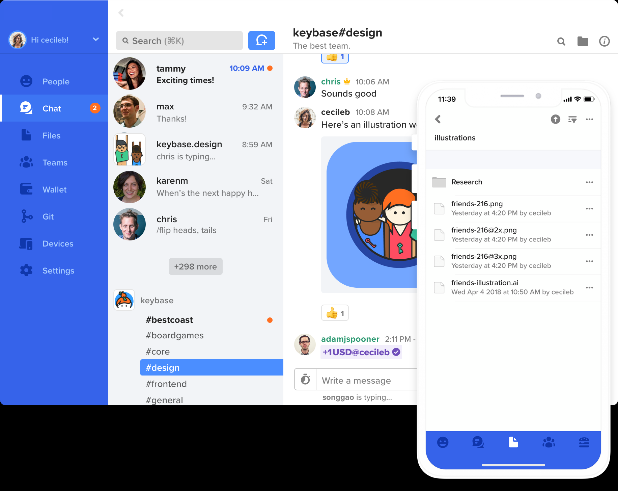
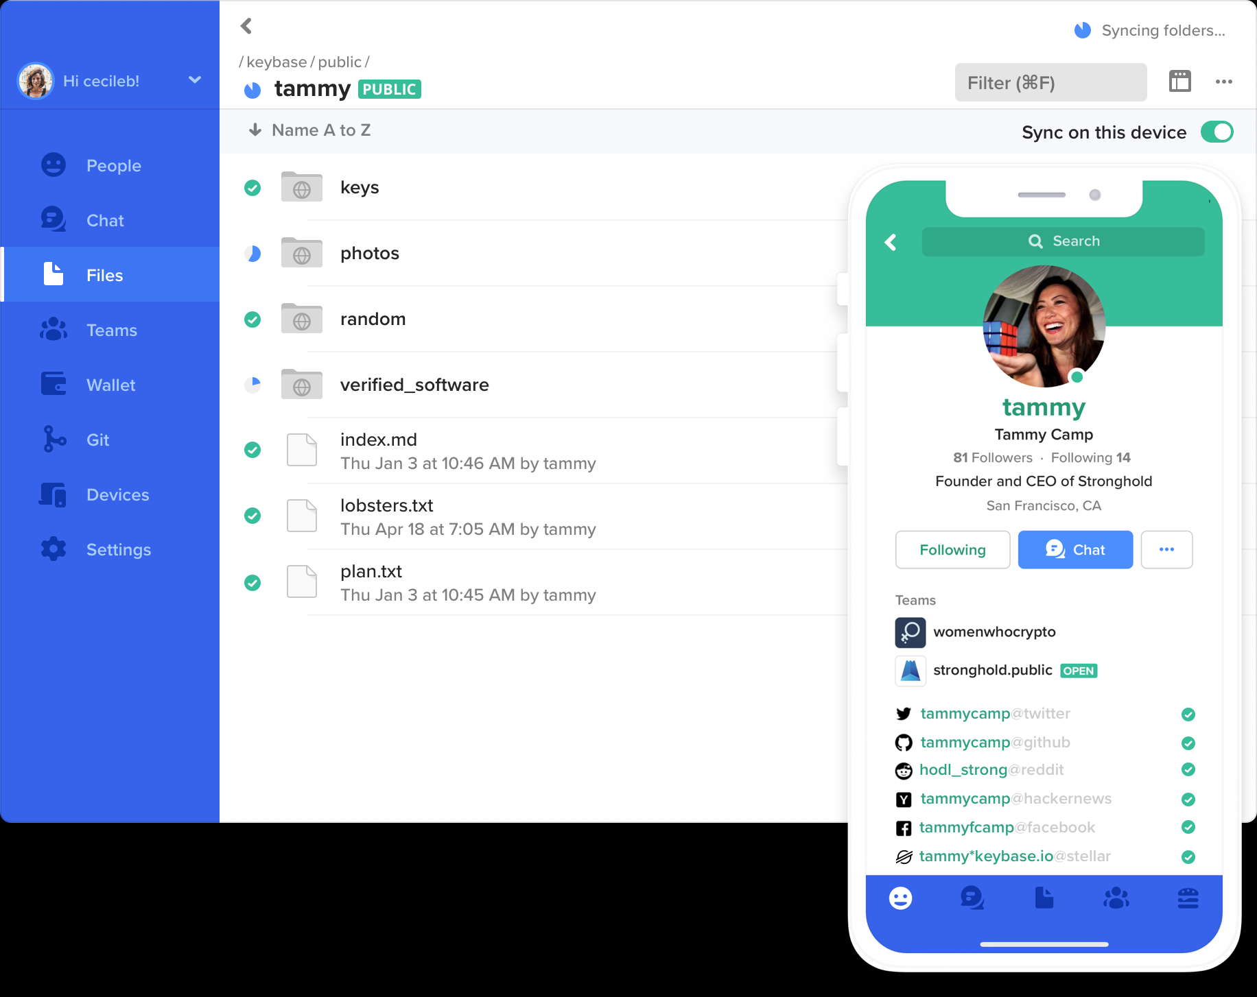
Keybase
Viral Communications
September 2019
Viral Communications
September 2019
Andrew Lippman
Andrew Lippman

Slide 17
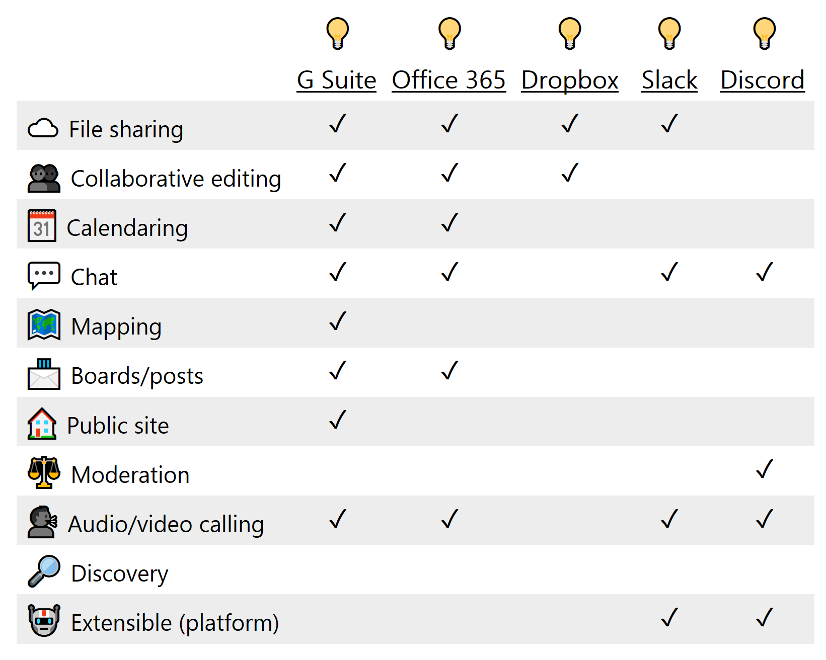
Services (freemium)
Viral Communications
September 2019
Viral Communications
September 2019
Andrew Lippman
Andrew Lippman

Slide 18
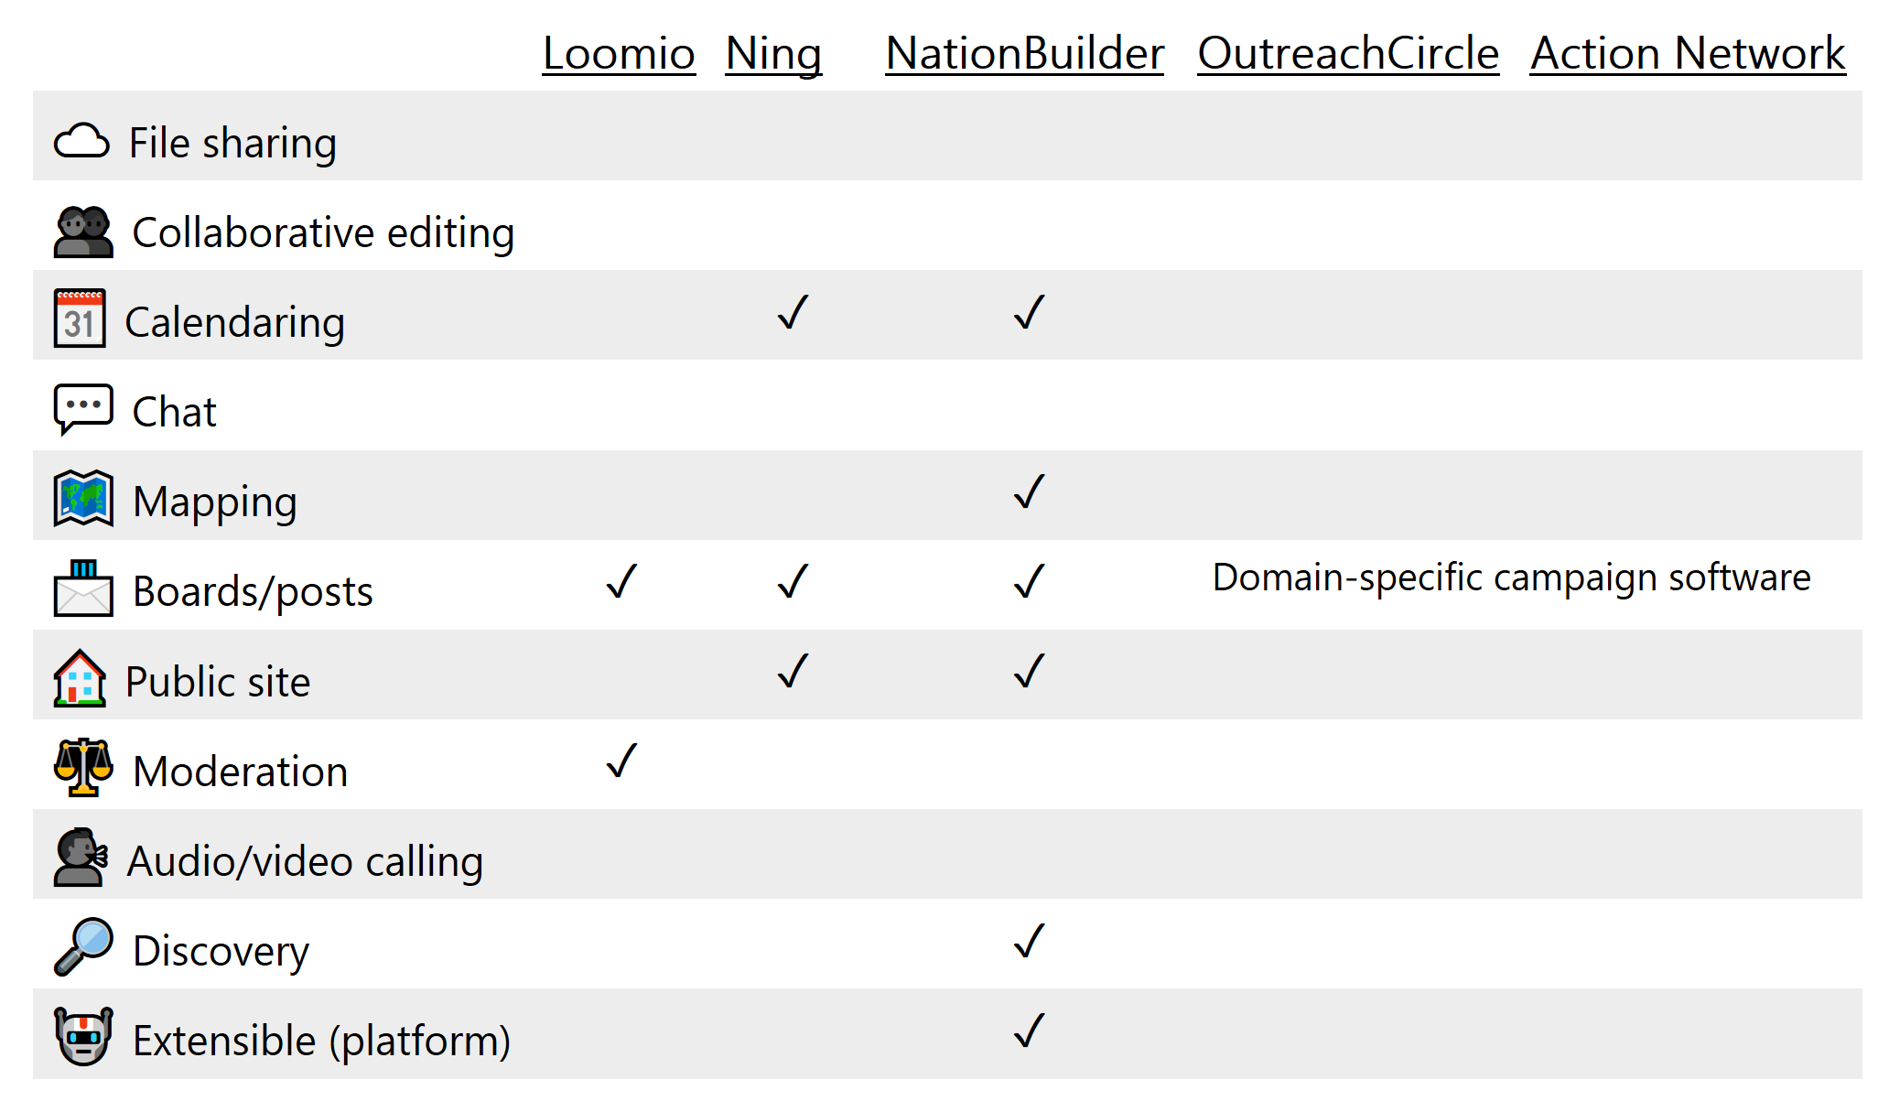
Services (premium)
Viral Communications
September 2019
Viral Communications
September 2019
Andrew Lippman
Andrew Lippman

